Slide 1
System Development Methods CT046-3-2
Information Systems Development Methods

Slide 2
Topic & Structure of the lesson
Revisiting System Development Lifecycle (SDLC)
Overview
Main Phases
Information System Development Methodologies

Slide 3
Learning Outcomes
By the end of this lecture, YOU should be able to :
Define SDLC
Illustrate SDLC
Briefly explain each of the SDLC phases
Identify the people involved in an IS project
Introduction to IS Methodologies

Slide 4
Key Terms you must be able to use
If you have mastered this topic, you should be able to use the following terms correctly in your assignments and exams:
Systems Development Lifecycle (SDLC)
Benefits of using SDLC
Different versions of SDLC
General types of people involved in an IS project
Definition of IS Methodologies

Slide 5
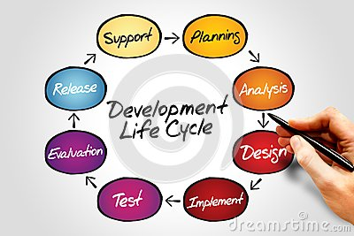
Systems Development Life Cycle (SDLC)
Standard definition;
The Systems Development Life Cycle (SDLC) is a conceptual model used in project management that describes the stages involved in an information system development project, from an initial feasibility study through maintenance of the completed application. (wiki,2015)

Slide 6
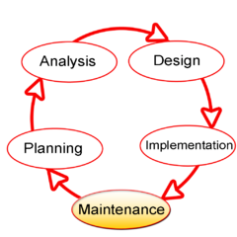
Systems Development Life Cycle (SDLC) Simplified Definition
A GENERAL RECEPIE to ‘cook-up’ an Information System
SDLC shows main stages:
PLANNING
ANALYSIS
DESIGN
IMPLEMENTATION
MAINTENANCE
(if any major problems, then back to planning)

Slide 7
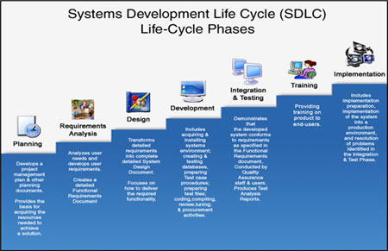
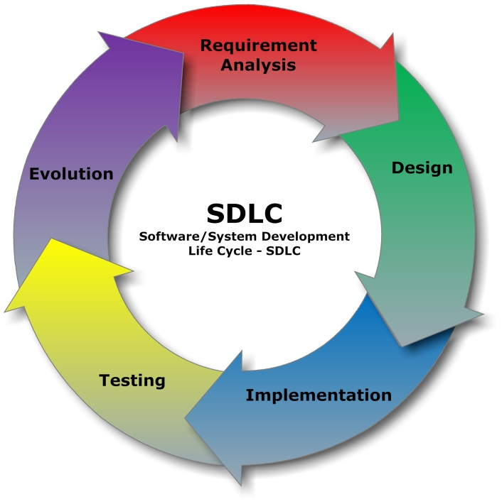
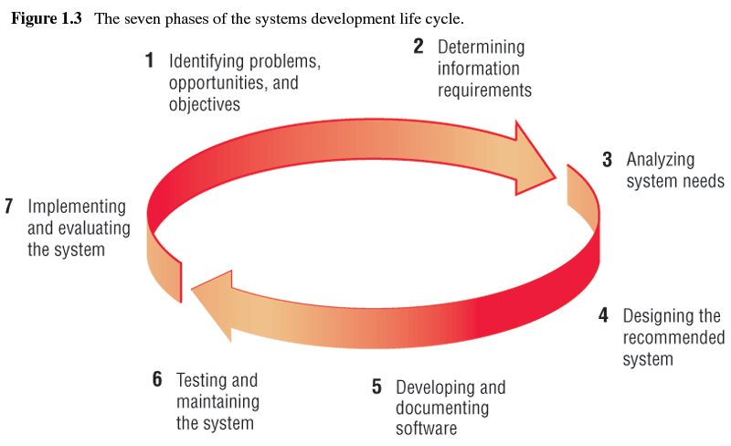
Many views of SDLC
SDLC has many version / diagrams / stages (from different authors), but generally all the same.
Search Google image for other versions

Slide 8
Facts about SDLC
SDLC is considered a framework to develop an Information System
SDLC acts as the basis for SYSTEM DEVELOPMENT METHODOLOGIES (covered in later chapters)
SDLC is not IS Development Methodology
SDLC can be generally used to manage any IT based project.
SDLC has Techniques to guide a developer to built an Information system efficiently.

Slide 9
PHASE-1 – Planning
Planning Sub Phases;
Problems Statement
Initial Study
Feasibility Study
Requirement Gathering
Input – Problem Statements
Output – Feasibility Study Report, Initial Study Report / Project Proposal
PLANNING
ANALYSIS
DESIGN
IMPLEMENTATION
MAINTENANCE

Slide 10
Quick Quiz
Who are the members of DEVELOPERS in an IT project?

Slide 11

PHASE-2 – Analysis
Requirement Analysis
Analyzing ‘Compiled Requirement’
Use several ‘Analysis Techniques’ to get best result.
Output – System Requirement Specification (SRS)
Popular Analysis Techniques;
Data Mining
Data visualization
Statistical Analysis
Data modeling
Filtering, sorting, clustering, etc.
PLANNING
ANALYSIS
DESIGN
IMPLEMENTATION
MAINTENANCE

Slide 12
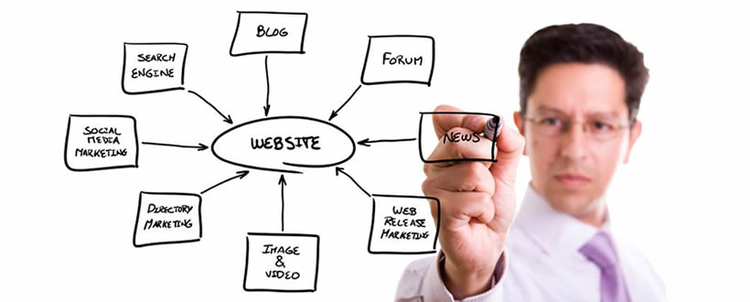
PHASE-3 - Design
System Design
Designing the new system
Design based on SRS (from Analysis Stage)
Output – Design Specification
Popular technics used;
Conceptual Design
Logical design
Data Design / Modeling
Physical Design
PLANNING
ANALYSIS
DESIGN
IMPLEMENTATION
MAINTENANCE

Slide 13
Quick Quiz
One of the popular type of ‘Physical Design’ is PROTOTYPE
What is a Software PROTOTYPE?
What's are the differences between a Prototype and a ACTUAL Product?

Slide 14

PHASE 4 – Implementation
Start building the actual components of the systems
Based on Design Specification
Output - Fully functional system
Main Activities :
Construction / Building the system
Perform various testing
Deploy new system
PLANNING
ANALYSIS
DESIGN
IMPLEMENTATION
MAINTENANCE

Slide 15

PHASE 5 – Review and Maintenance
Developer perform review of system after deployment
Problems are fixed / prevented through Maintenance Process
Project Owner may hire different company to do this.
Types of Maintenance:
Corrective
Preventive
Adoptive
Perfective
PLANNING
ANALYSIS
DESIGN
IMPLEMENTATION
MAINTENANCE

Slide 16
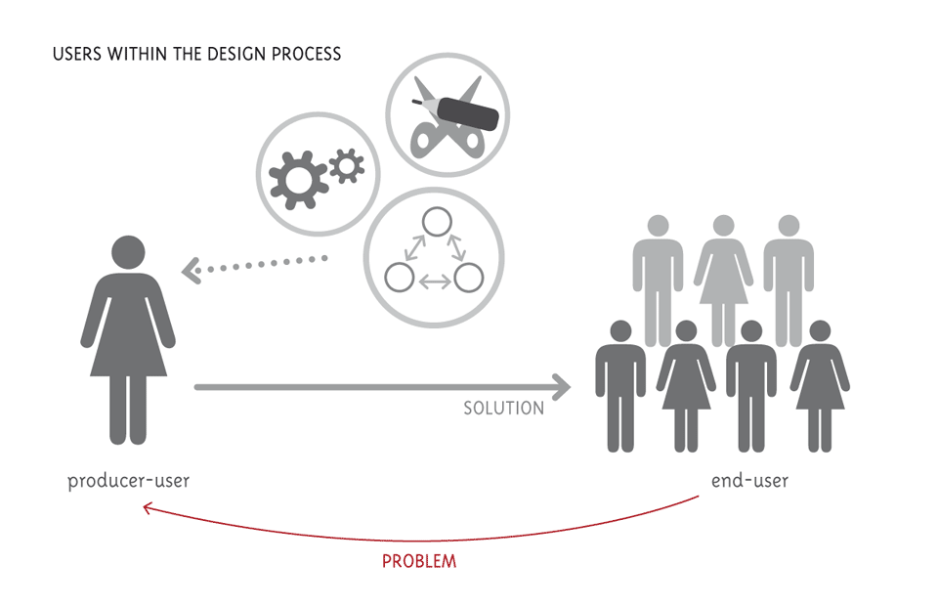
People involved in SDLC
System Owners
Users
Developers
System Administrators

Slide 17
People involved in SDLC Quick Quiz
If you are suppose to build new website for APU, who are the People involved?
(Ex; USERS would include Lecturers and …)
System Owners?
Users?
Developers?
System Administrators?
NOTE
System Owners
People who pay and own the system
User
People who directly/indirectly use the new system
Developers
People who do research and create a new system
System Administrators
People who ‘take-care’ of the system after it is done

Slide 18

What is Systems Development Methodology ?
Official definition
“A software development methodology or system development methodology in software engineering is a framework that is used to structure, plan, and control the process of developing an information system”
Simplified Definition
A Specific Recipe to ‘cook-up’ an specific type of Information System
(In comparison to SDLC which viewed as GENERAL recipe)

Slide 19

What is Systems Development Methodology ?
Contains detailed steps to be carried out at specific situations / specific type of project
Some popular IS Development Methodologies
Waterfall Model – most basic methodology close to SDLC
SSADM – used for large database projects
WISDM – used for web based projects
Spiral – used for project which has many sections but need to be linked later.
RAD – used for small and fast projects
XP – For advance / heavy coding projects

Slide 20
Other popular IS Methodologies
V-Model
Scrum
Cleanroom
DSDM
Lean
Dual Vee Model
TDD

Slide 21

What makes up a Systems Development Methodology ?
Methodologies uses TOOLS and TECHNIQUES to carry out tasks.
TOOLS – often CASE TOOLS; software used within the project
Testing Tool – Software used to test other software.
Code Generator – Software used to generate programming codes from design.
TECHNIQUES - different ways of doing things.
Prototyping – A model of the system developed to get feedback
JAD- Meeting session used to review project

Slide 22

Importance of using IS Methodologies
To ensure consistency in management of projects
To ensure the best techniques applied to carry out a project.
Reduce time & cost
To improve the quality of work & system
Meet user requirement

Slide 23
Quick Quiz
What methodology do you use for a project which involves large database and lots of coding?

Slide 24
Tutorial 1
(Group Work)
Use a large paper to draw SDLC
Make a summary of SDLC Main Phases and sub-phases.
Under each Main Phases, shows it’s:
Sub-phases
Who are involved
Input document
Output documents
Popular Techniques used within the phase (if any)

Slide 25
Tutorial 2
(Individual Work)
What is SDLC?
Explain THREE benefits of applying SDLC for a IS project.
Explain THREE problems of applying SDLC for a IS project.
Search the internet/books and draw a diagram for SDLC (which is not found in these slides).

Slide 26
Next Session
Structured Methodologies

